Slide 1
Floware: Data sci exercise
Pyae Sone Kyaw

Slide 2


AGENDA
INTRODUCTION
Basic Tasks
Advanced task
SUMMARY

Slide 3


INTRO
My name is Pyae Sone Kyaw. You can call me Sone. I’m 24 from Myanmar.
I will be a graduate of M1 DSAI- AIT and M2 DANI- TSP.
Hoping for Knowledgeable Internship Experience.

Slide 4
Basic Tasks
EDA

Slide 5
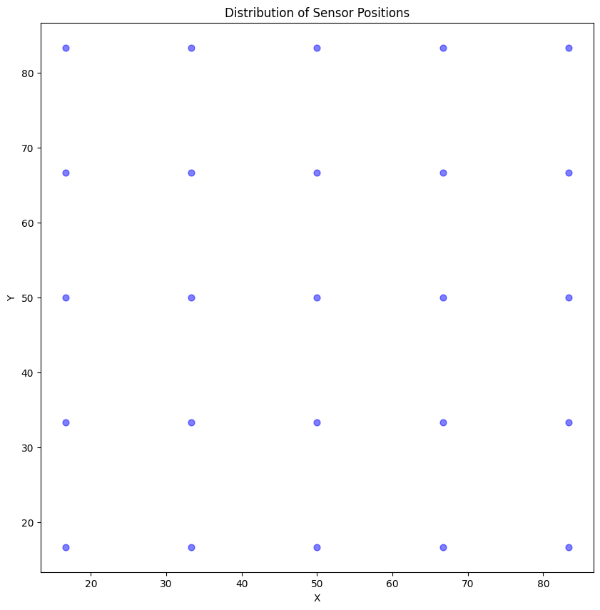
Visualize the distribution of sensor positions
Notes:
___Uniform Coverage___: A grid layout ensures that the sensors cover the space evenly. This is important for Bluetooth signal detection, as it minimizes areas without sensor coverage (i.e., "dark spaces").
___Simplified Analysis___: A regular grid pattern can make it easier to interpret and analyze movement patterns within the space. The data becomes more structured and predictable.

Slide 6
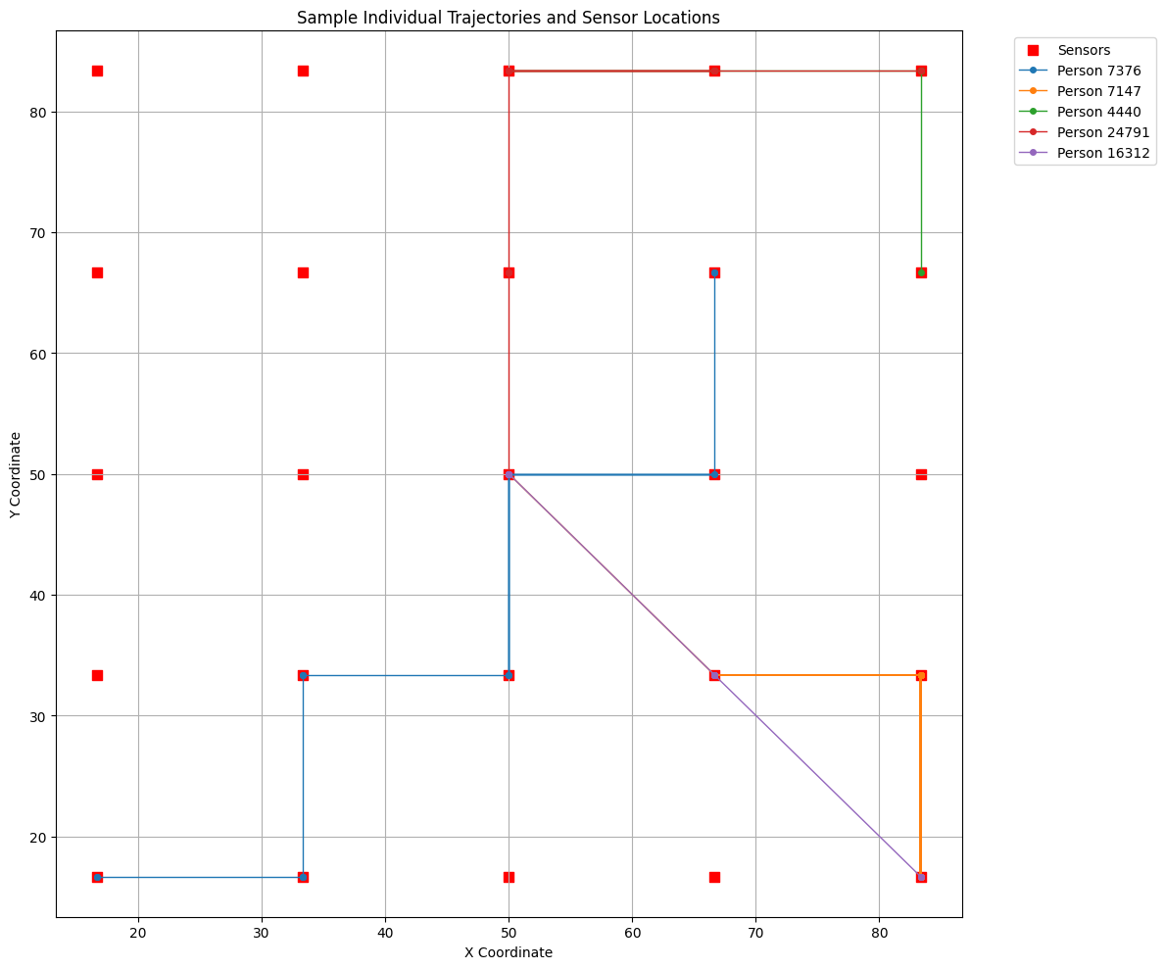
Trajectories Analysis of some individuals
Notes:
___Uniform Coverage___: A grid layout ensures that the sensors cover the space evenly. This is important for Bluetooth signal detection, as it minimizes areas without sensor coverage (i.e., "dark spaces").
___Simplified Analysis___: A regular grid pattern can make it easier to interpret and analyze movement patterns within the space. The data becomes more structured and predictable.

Slide 7
Basic Tasks
Data Processing

Slide 8
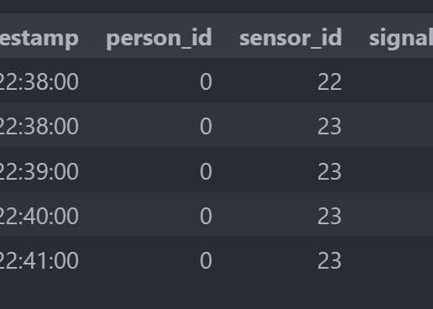
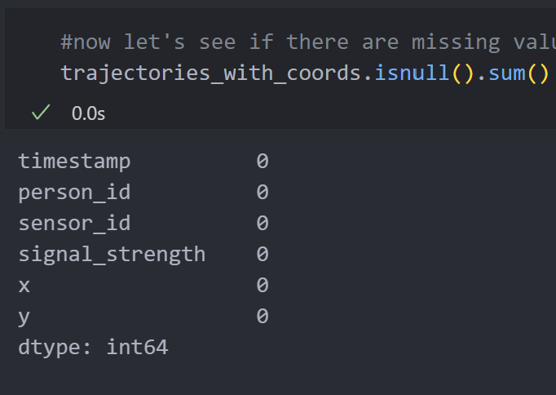
Missing values &Normalization
Notes:
___Uniform Coverage___: A grid layout ensures that the sensors cover the space evenly. This is important for Bluetooth signal detection, as it minimizes areas without sensor coverage (i.e., "dark spaces").
___Simplified Analysis___: A regular grid pattern can make it easier to interpret and analyze movement patterns within the space. The data becomes more structured and predictable.

Slide 9
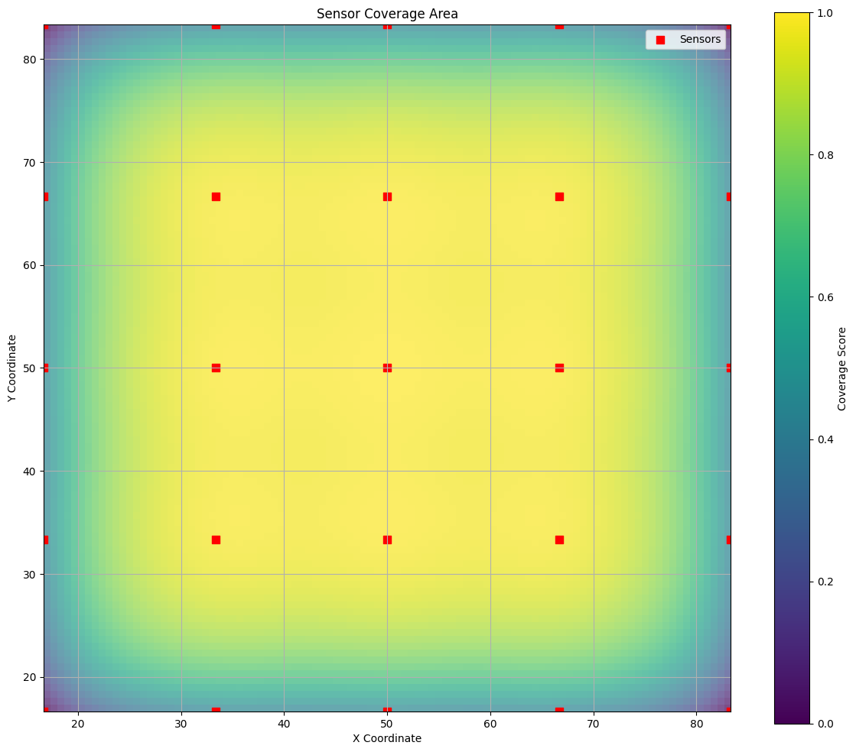
Visualize the coverage area of sensors based on sensor_map
Notes:
___Uniform Coverage___: A grid layout ensures that the sensors cover the space evenly. This is important for Bluetooth signal detection, as it minimizes areas without sensor coverage (i.e., "dark spaces").
___Simplified Analysis___: A regular grid pattern can make it easier to interpret and analyze movement patterns within the space. The data becomes more structured and predictable.

Slide 10
Basic Tasks
Time-Series Analysis

Slide 11
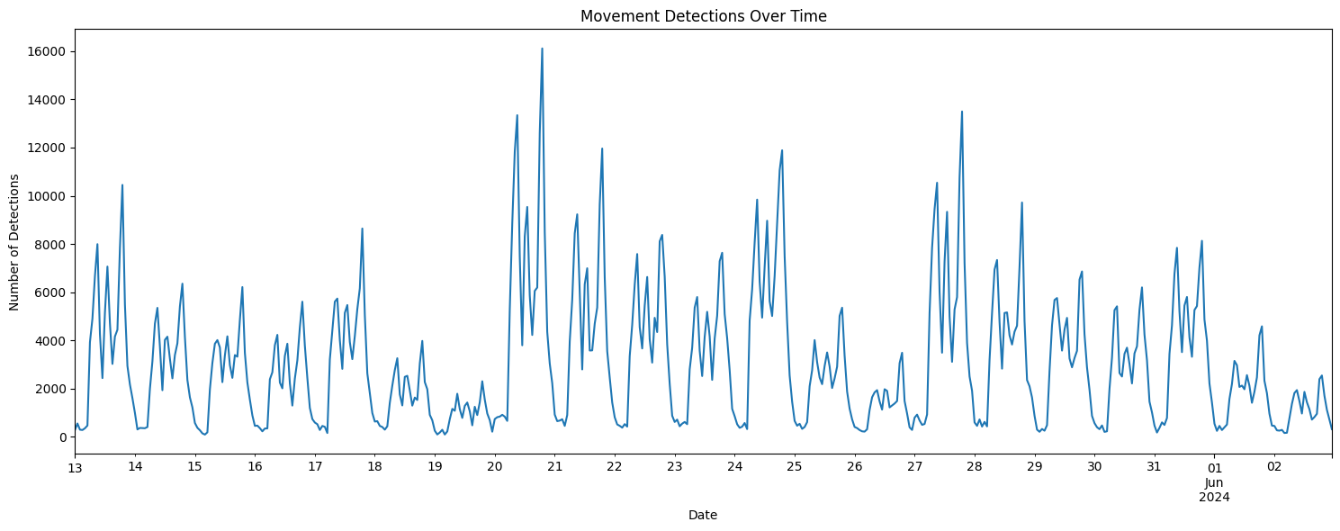
Overall Motion Capture

Slide 12
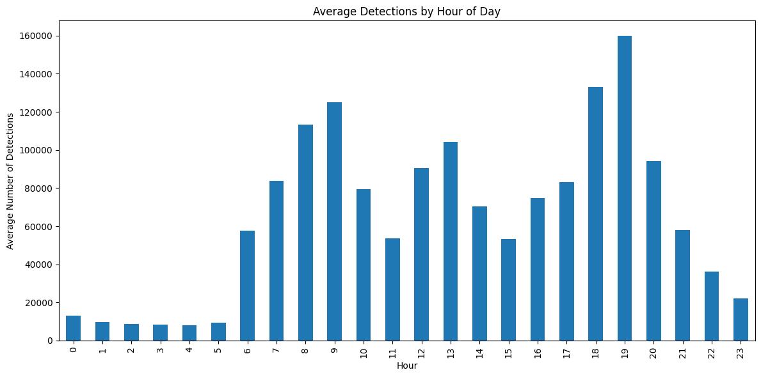
AVG Motion Capture by Hour

Slide 13
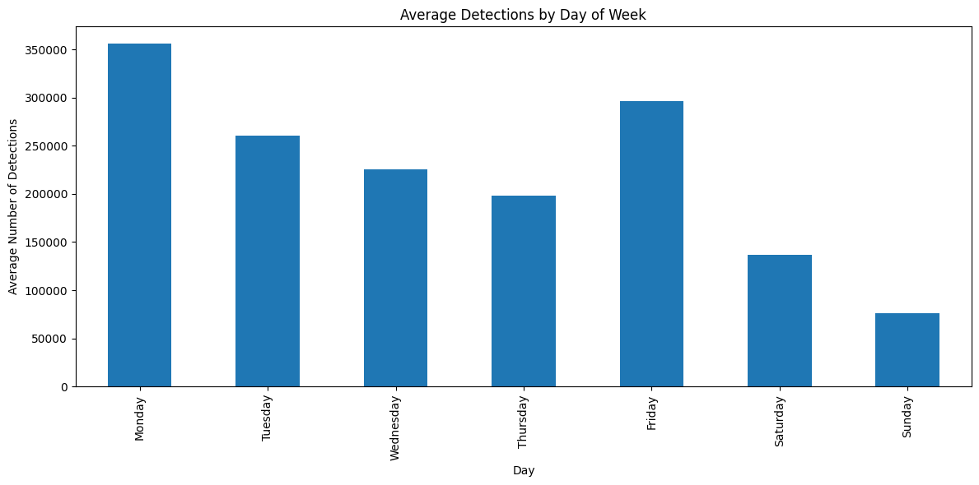
AVG Motion Capture by DAy

Slide 14
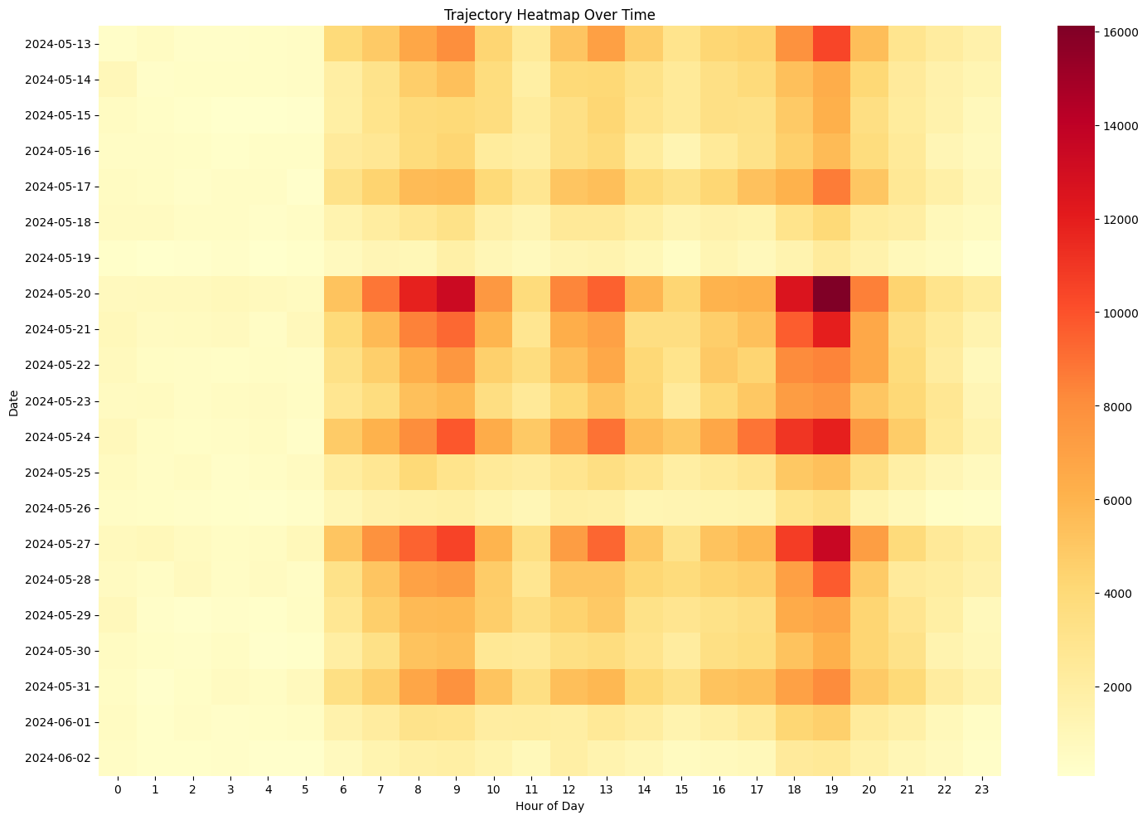
ALL-in-ALL Capture
Notes:
We go on details in next slides and analysis

Slide 15
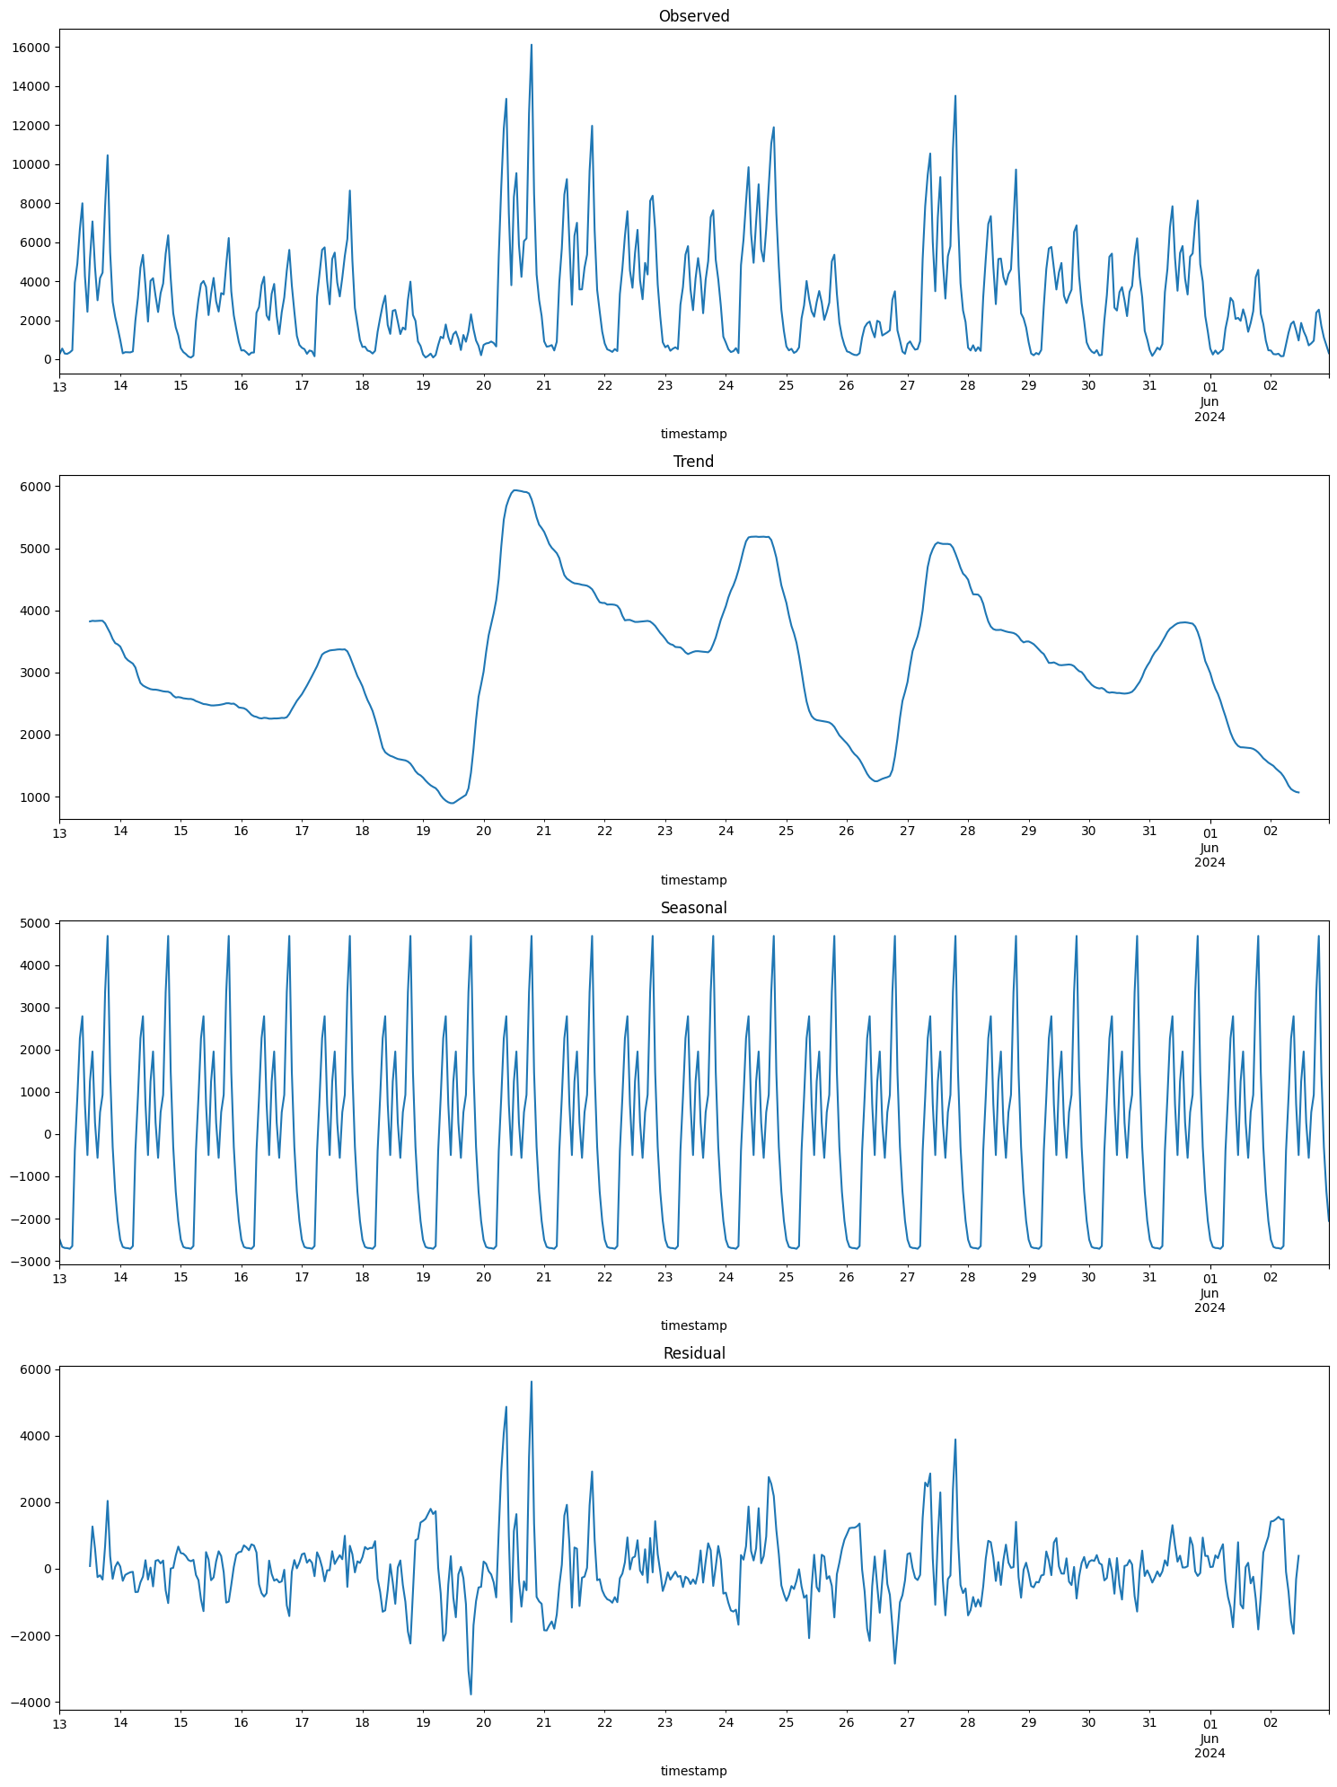
Decompose and forecast movements relative to sensor positions
Notes:
This decomposition show us the trend, seasonal patterns, and residual noise in our movement data.

Slide 16
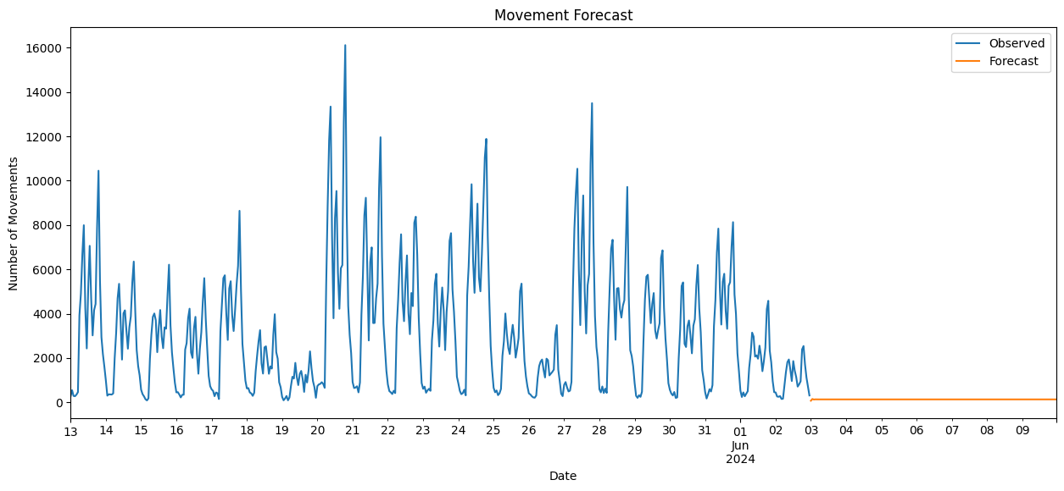
Forecasting Future movements

Slide 17
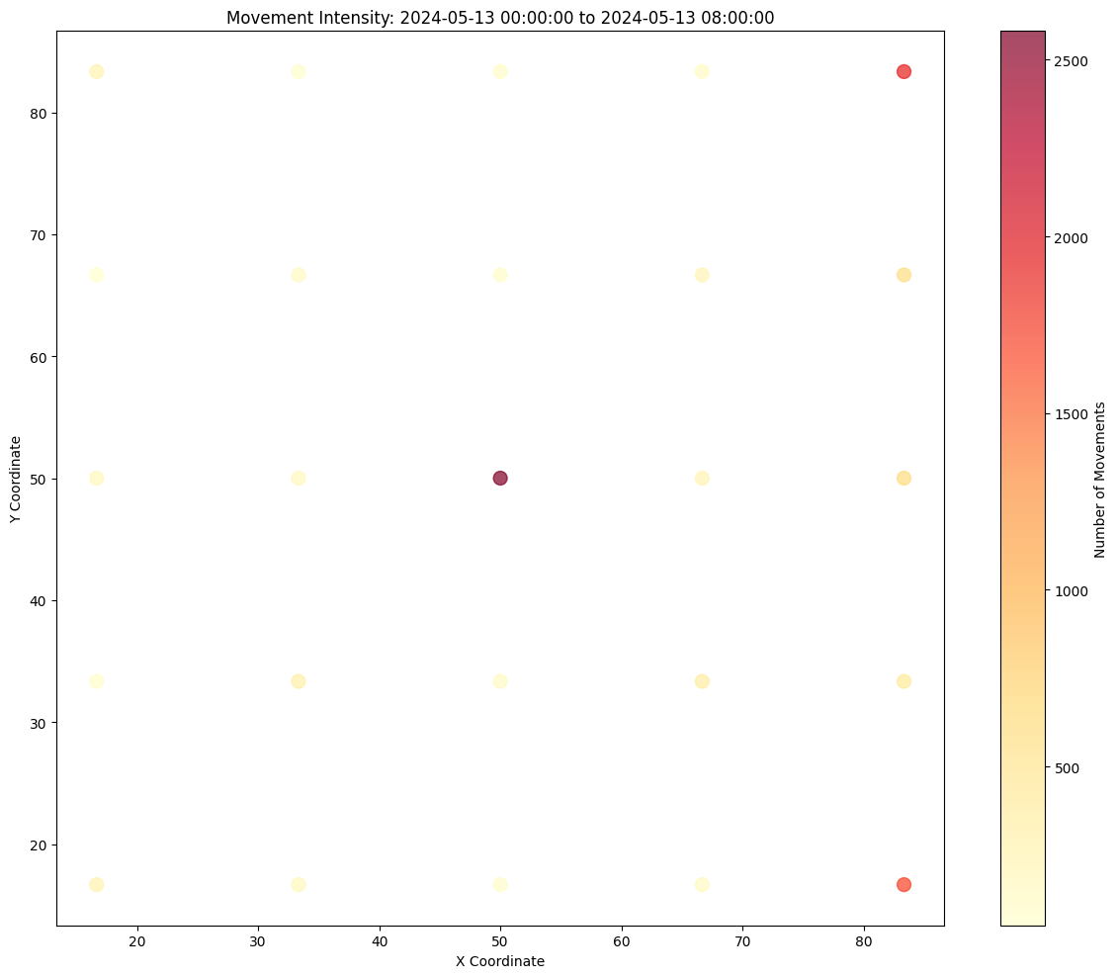
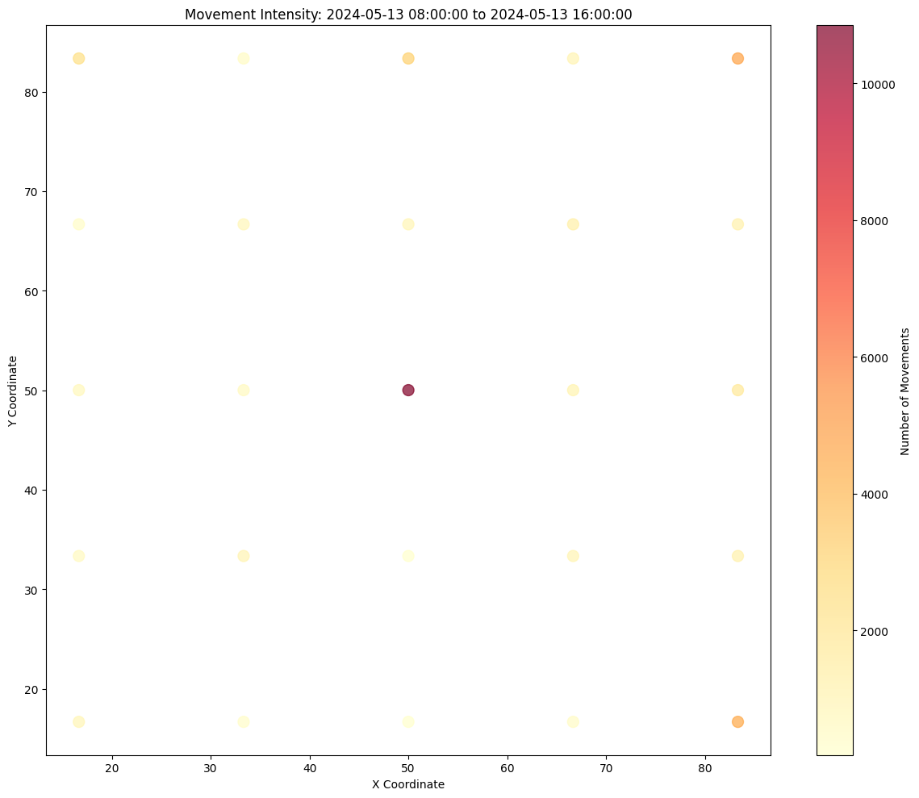
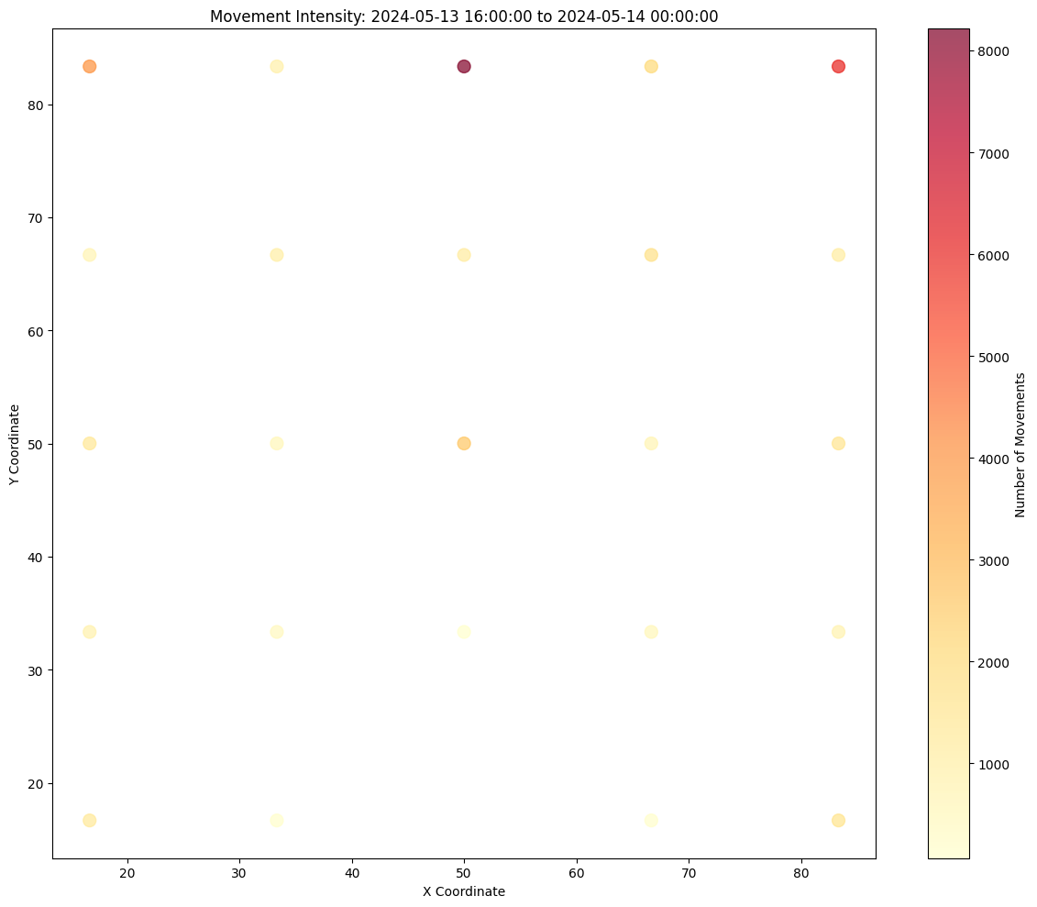
movements relative to sensor positions
Notes:
We go on details in next slides and analysis

Slide 18
Basic Tasks
Thorough Peak Analysis

Slide 19
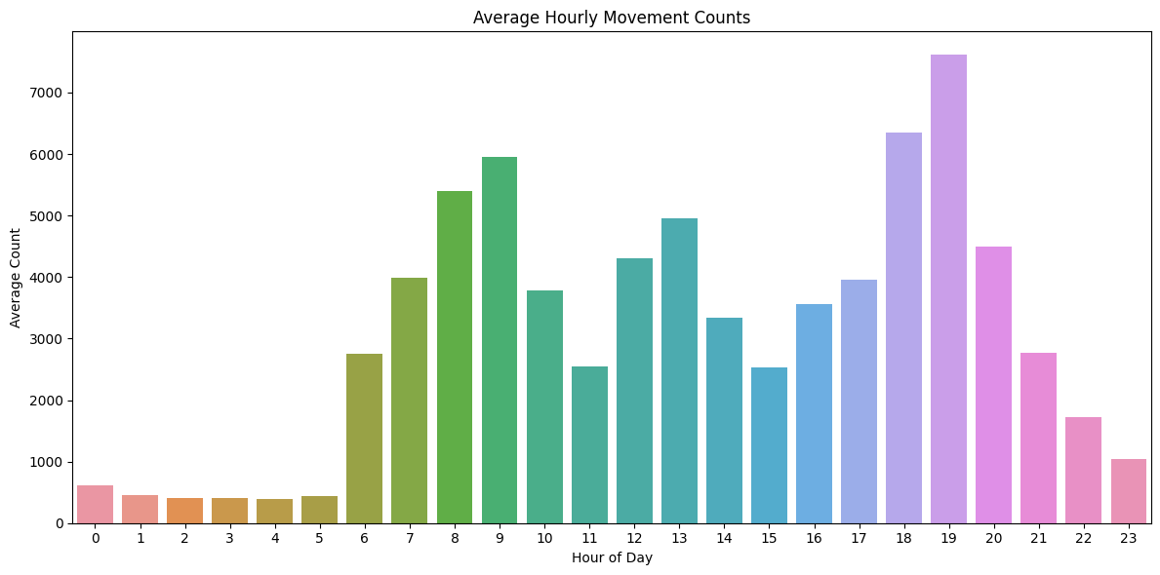
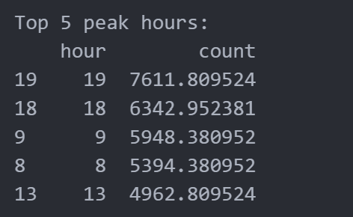
Hourly Peak TIme

Slide 20
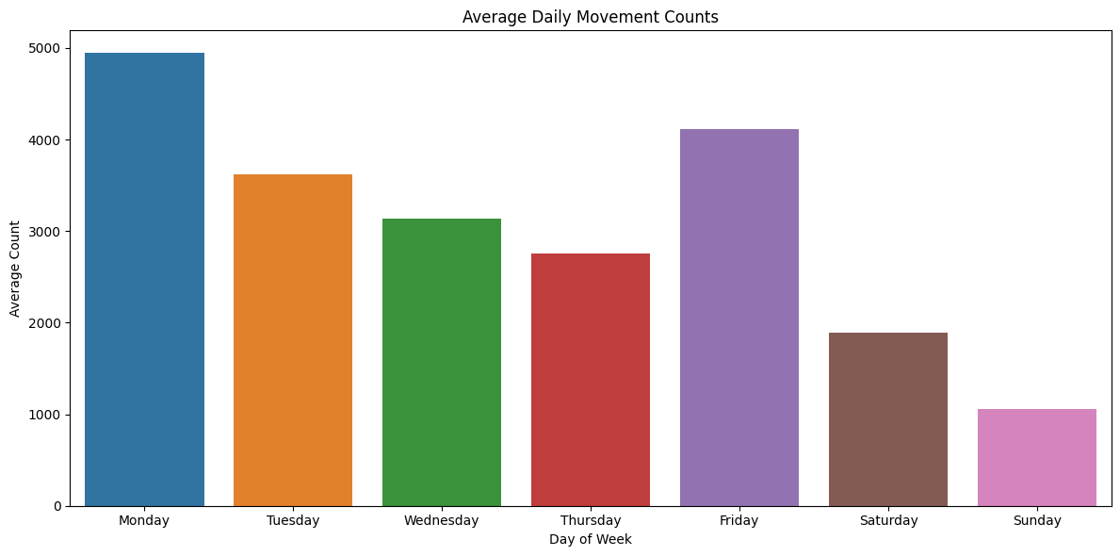
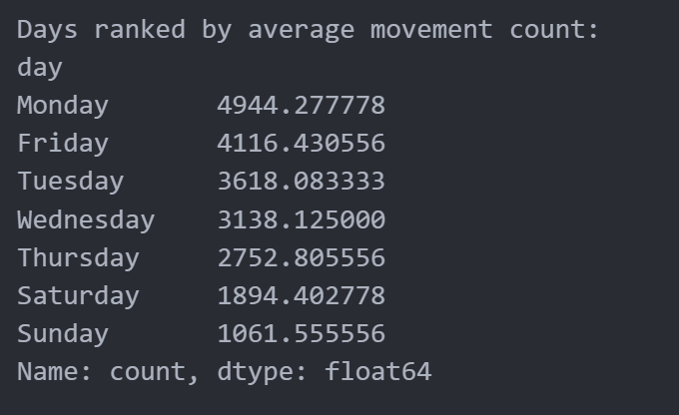
Daily Movement Peak
Notes:
Interesting here since we got Monday and Friday as the busiest days . As we can imagine Monday is the start of the week and Friday is the end of the week meaning we need our start of the week motivation and the end of the week relaxation either music or podcast or any other audio that we prefer to listen to for this two days of the week hence the movement is high on these days.( we are connected to our earbuds or headphones more on these days)

Slide 21
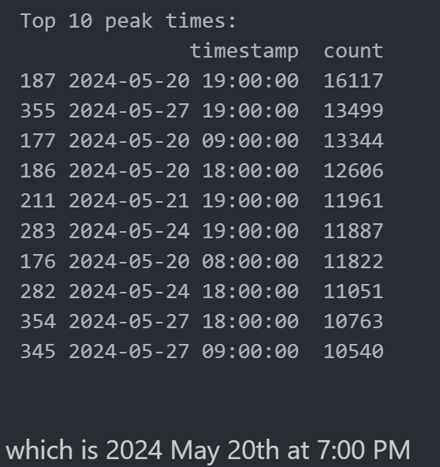

Overall Peak

Slide 22
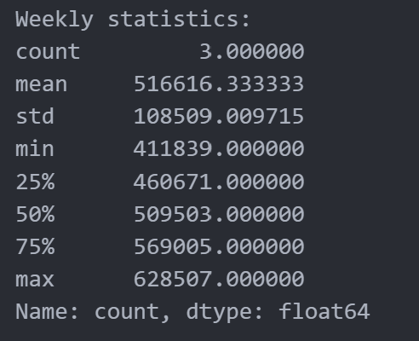
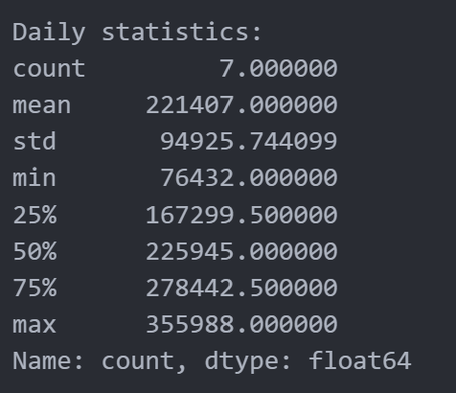
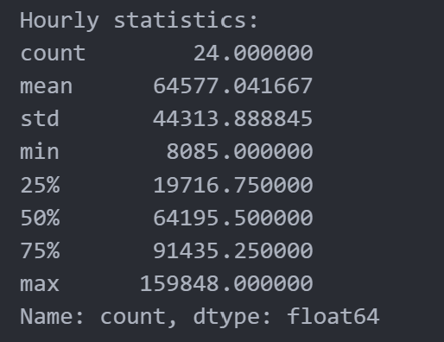
Some Stats

Slide 23
Basic Tasks
Spatial Analysis

Slide 24
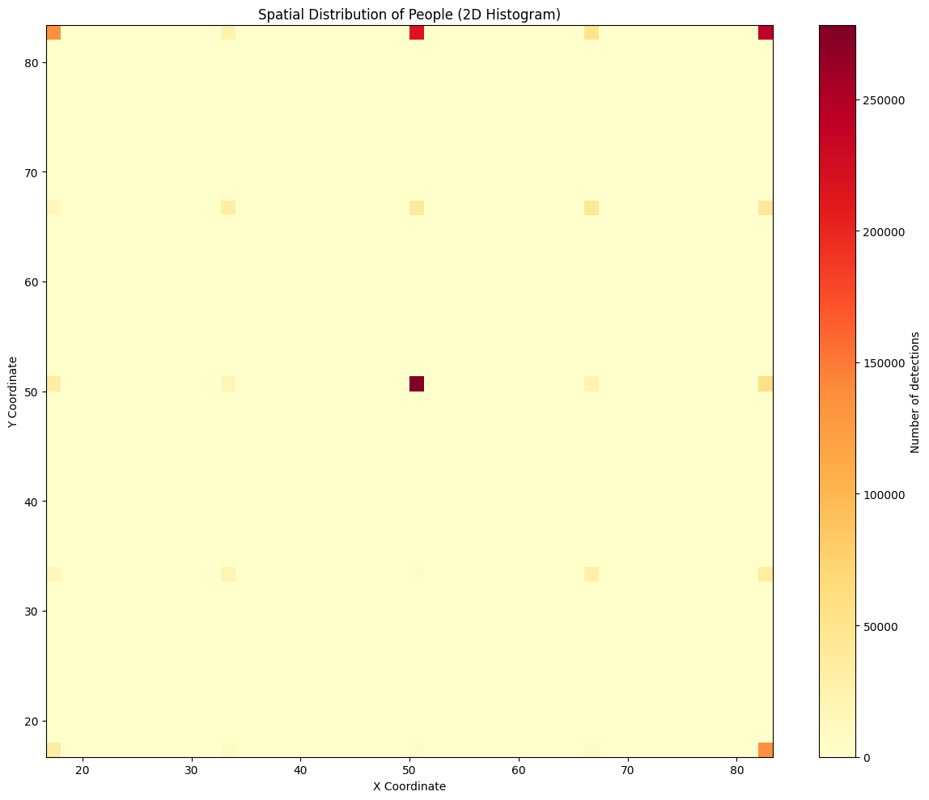
the spatial distribution of people
Notes:
We have a great sense of where to place the sensors!

Slide 25
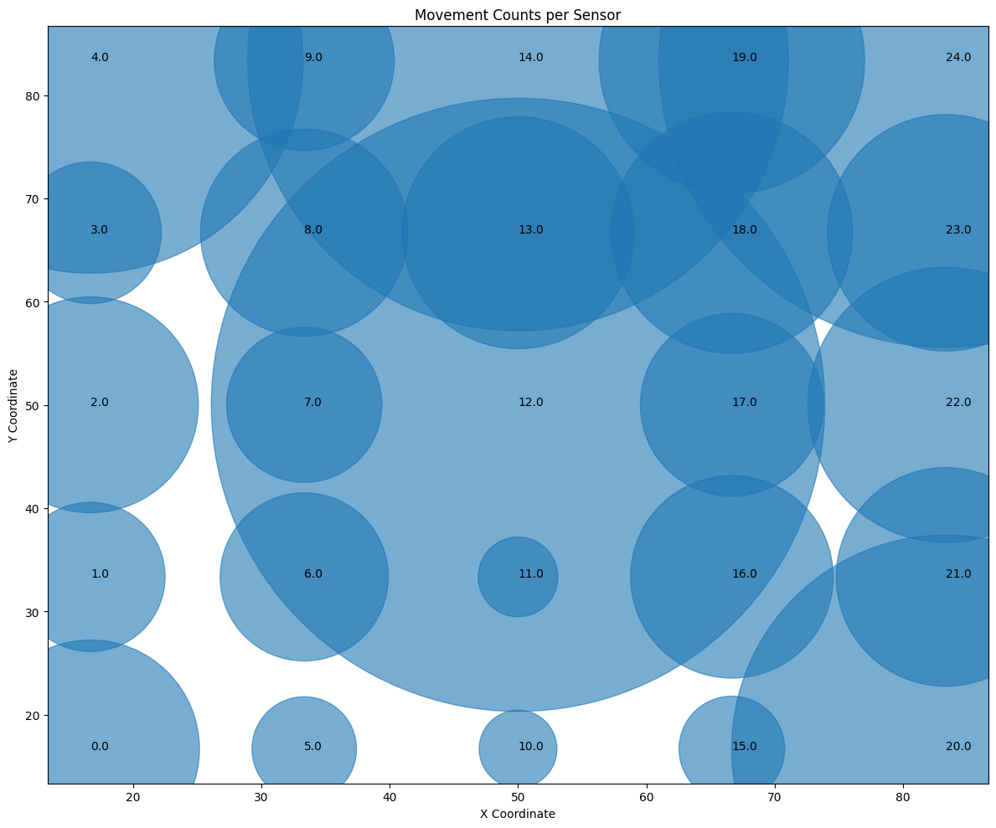
Movement pattern Between Sensors
Notes:
We have a great sense of where to place the sensors!

Slide 26
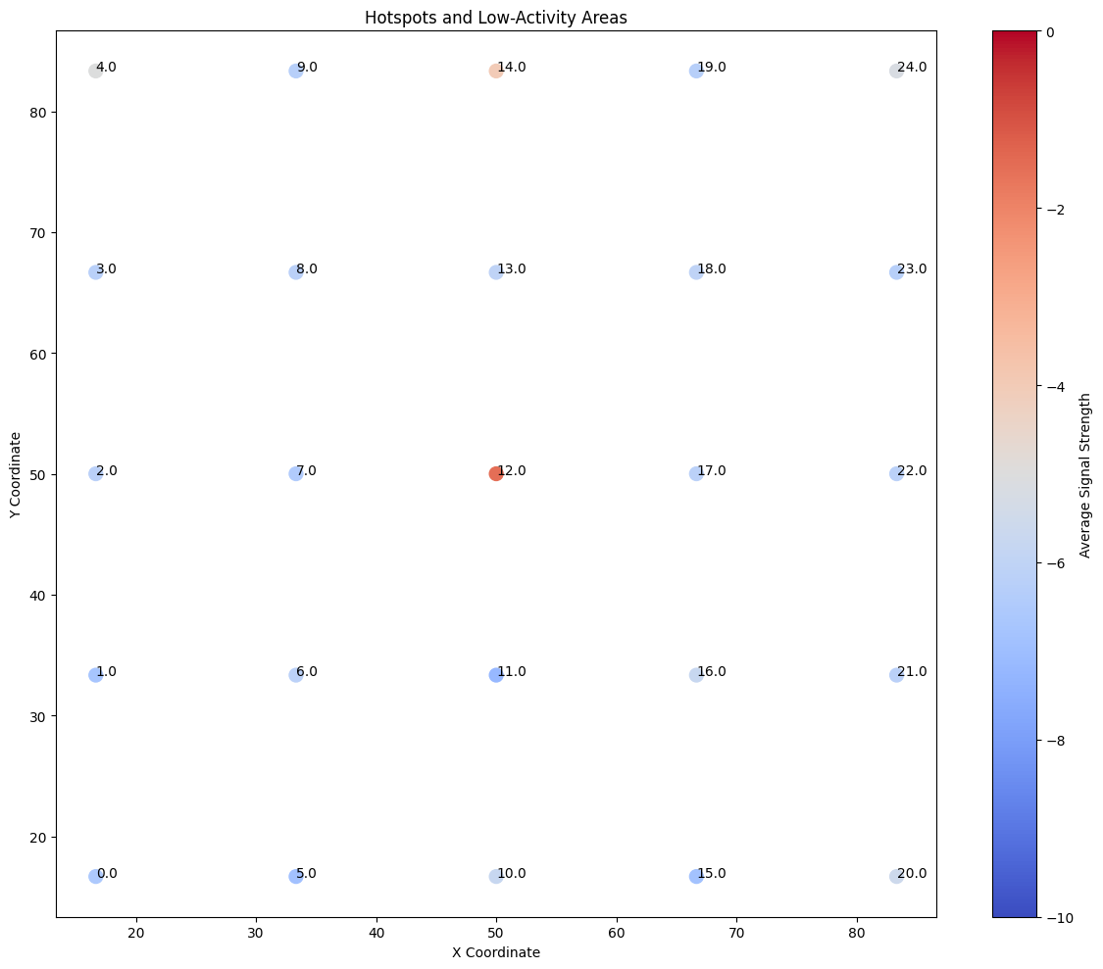
Identify hotspots and low-activity areas
Notes:
This plot help us identify areas of high and low activity based on signal strength.

Slide 27
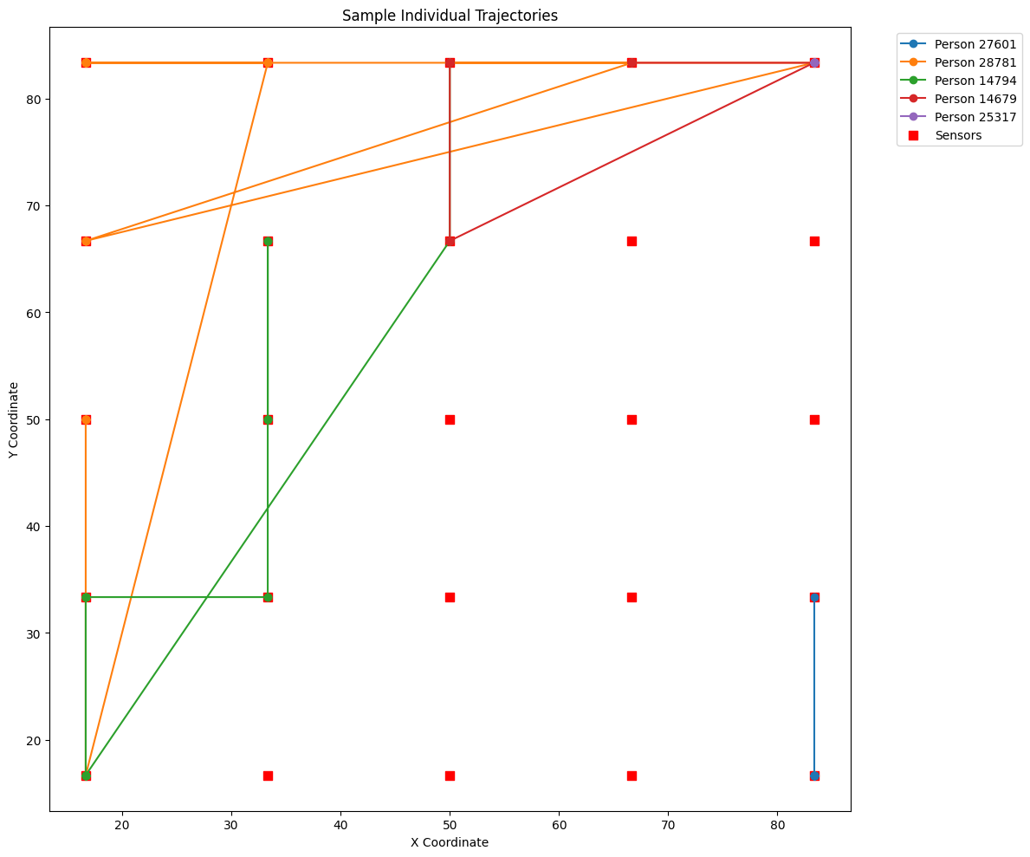
Individual Trajectories
Notes:
This plot help us identify areas of high and low activity based on signal strength.

Slide 28
Advanced Task
Predictive Modellling

Slide 29
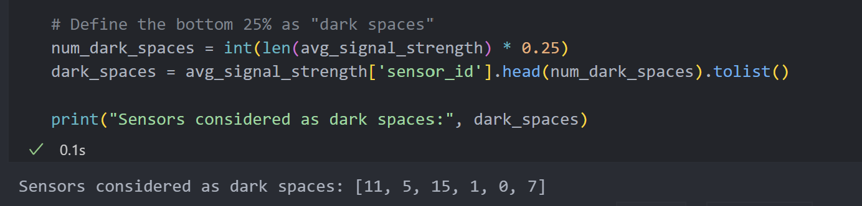
Defining Dark Spaces
Notes:
Based AVG Signal Strength

Slide 30
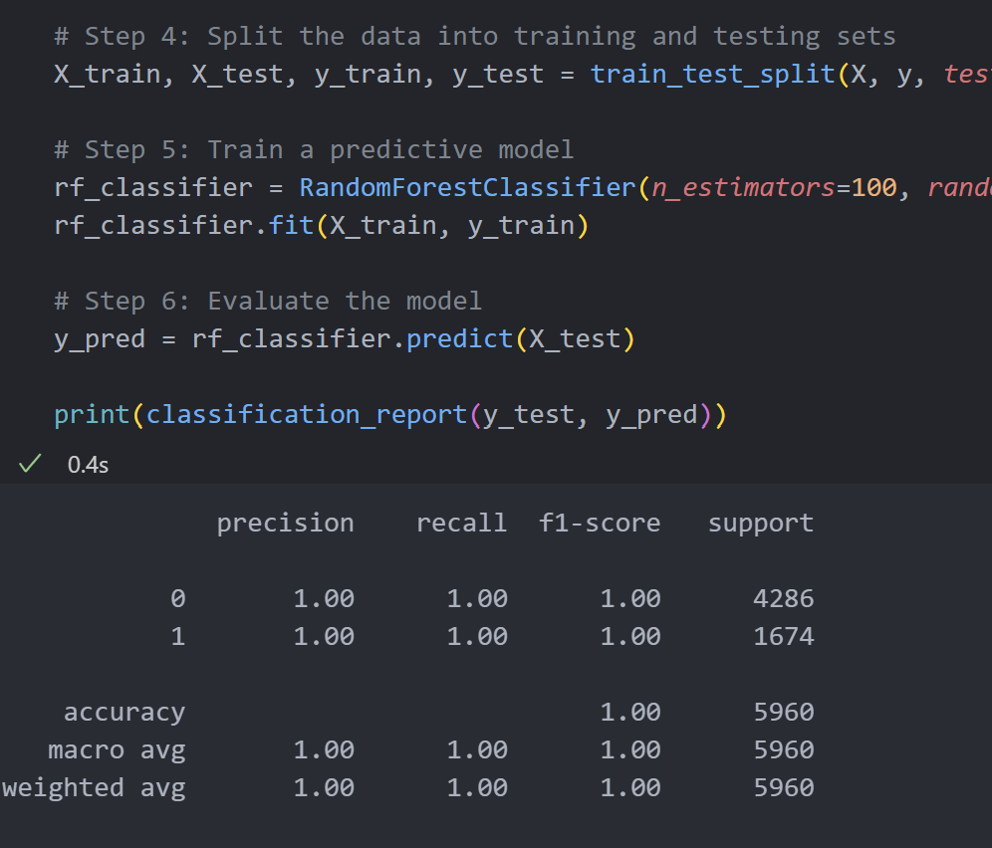
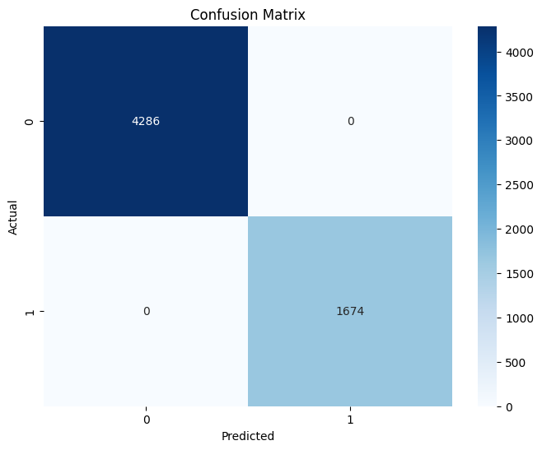
Train our Model
Notes:
Based AVG Signal Strength

Slide 31
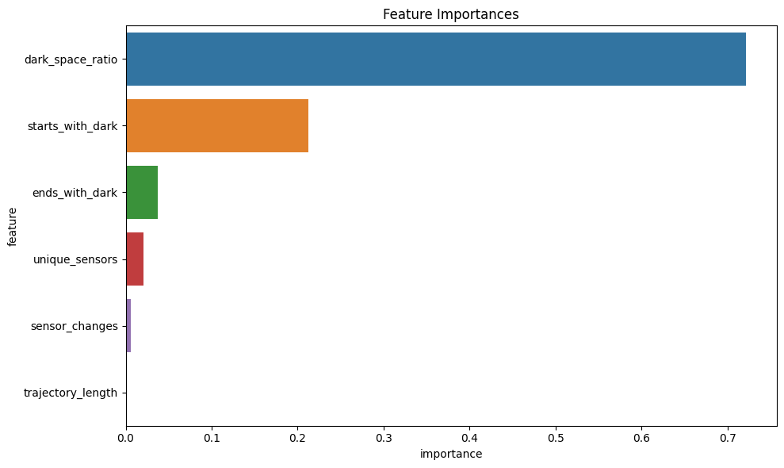
Feature Importance
Notes:
Based AVG Signal Strength

Slide 32
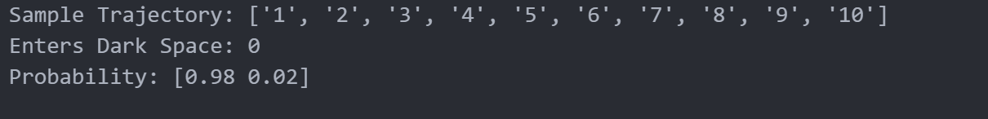
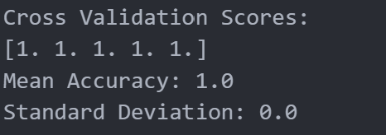
Inference & Evaluation
Notes:
the cross-validation scores are [1. 1. 1. 1. 1.] which is a perfect score. This means that the model is able to predict whether a person will enter a dark space with 100% accuracy. This is likely due to the simplicity of the problem and the strong relationship between signal strength and sensor location.

Slide 33

SUMMARY
Good DATA SCIENCE EXERCISE FOR ME!

Slide 34
THANK YOU
Pyae Sone Kyaw

